Slide 1



Slide 2
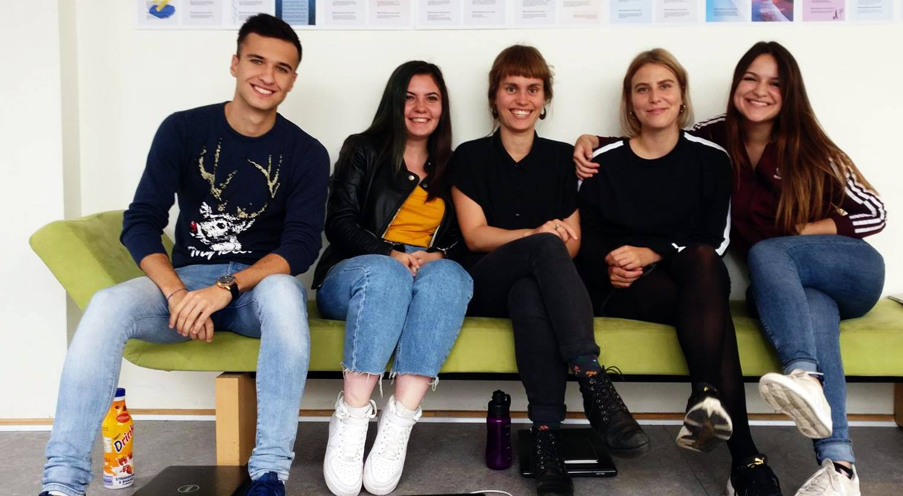
Meet group 12

Slide 3
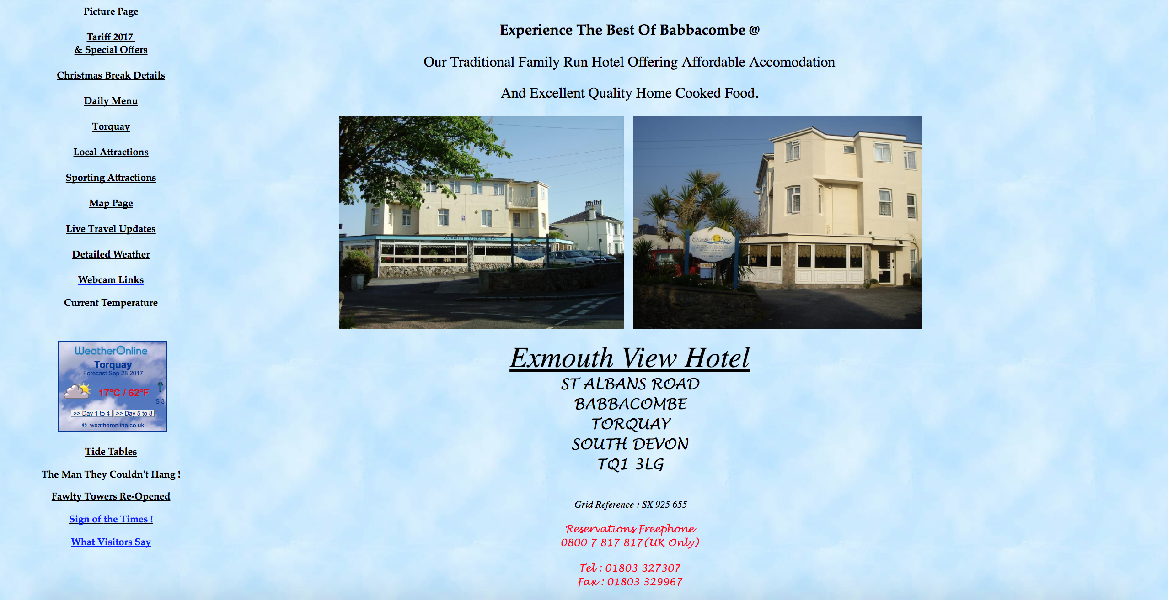
Existing website

Slide 4
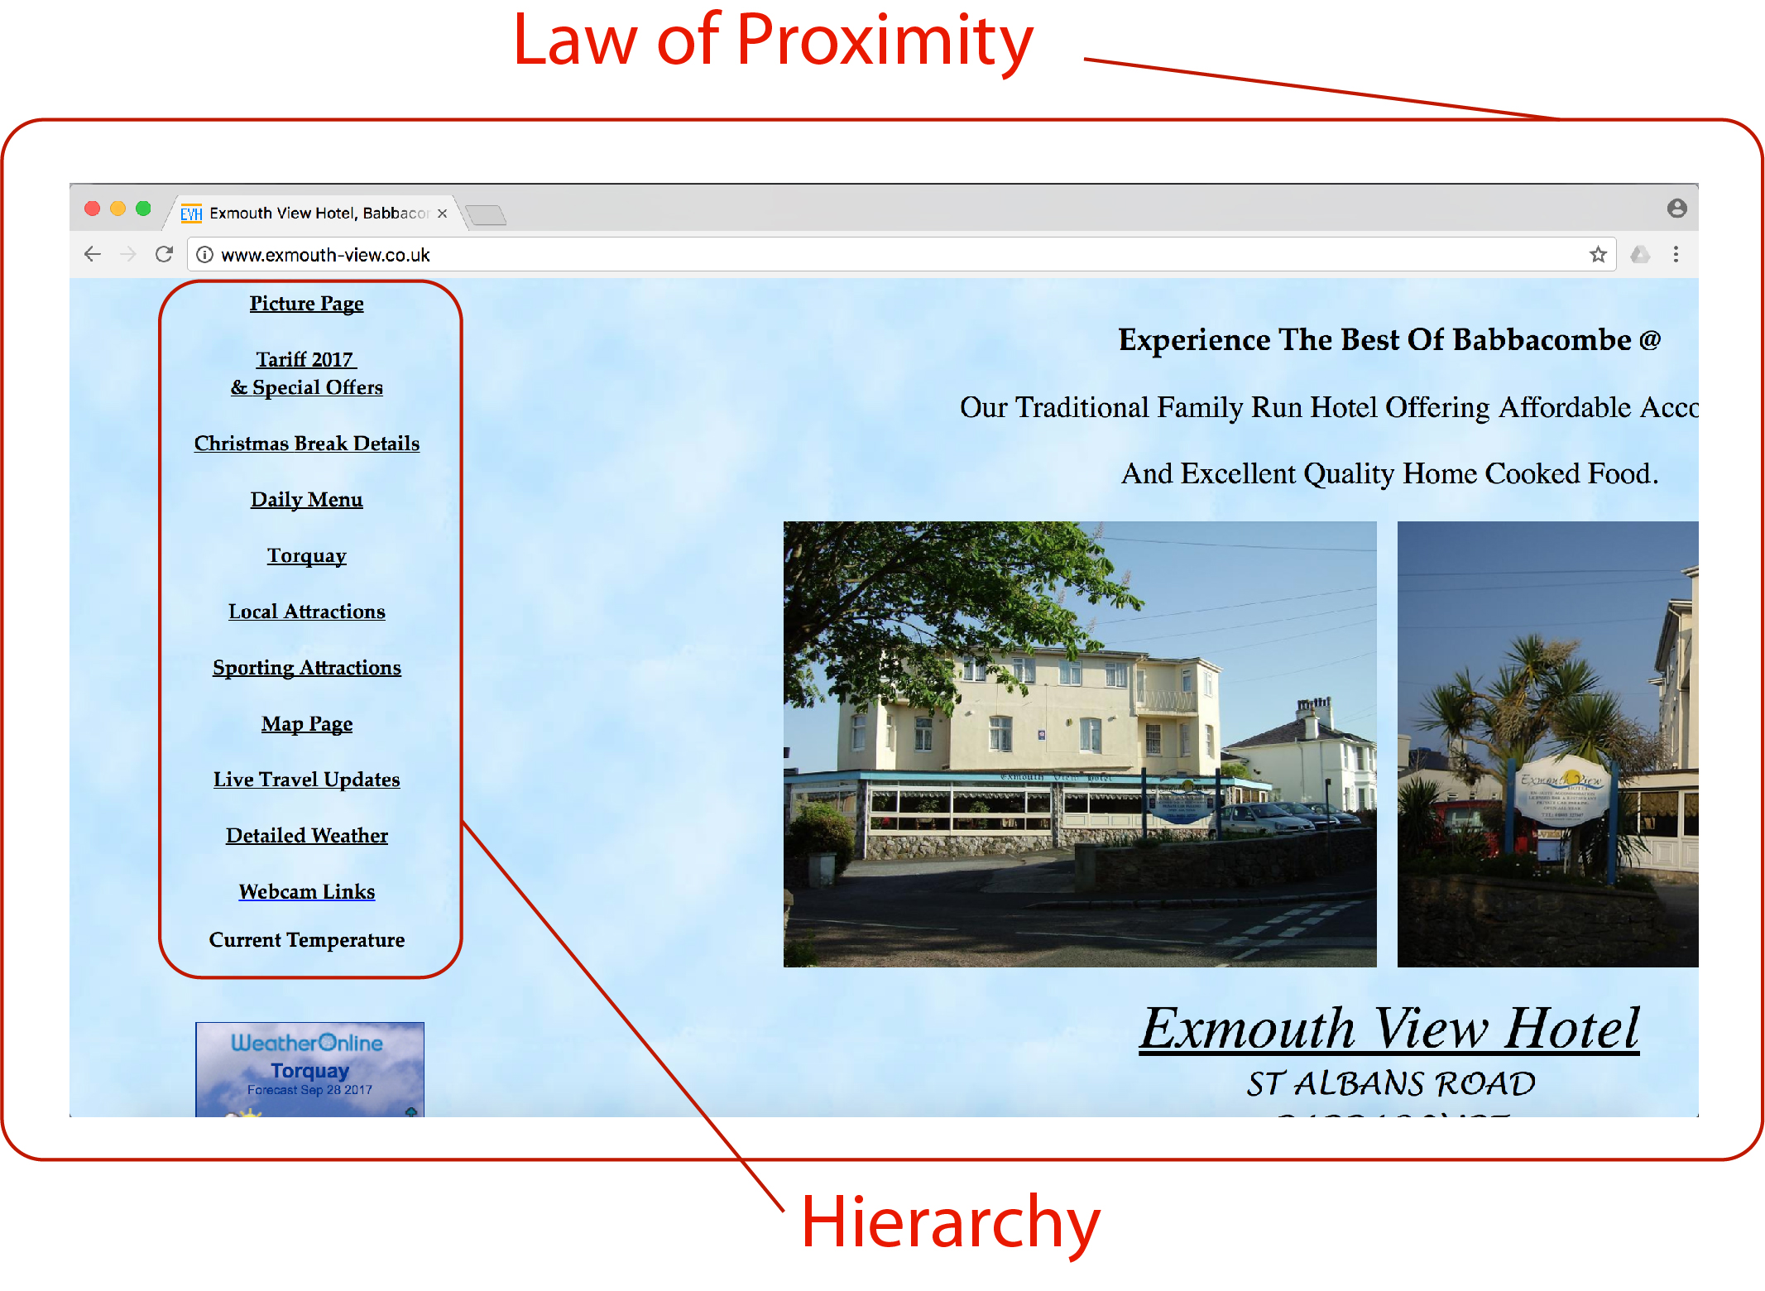
Bad design principles

Slide 5
Test report
Bad navigation
When a user visits the page, he really doesn’t understand what objects belong together so he can’t group them and properly use the website.
Unclear contact informations
Users didn´t find where is the Hotel and how to contact it because the websites frontpage wasn´t responsive and you had to first go right and then down in the frontpage. There wasn´t any contact section in navigation menu either.

Slide 6

Moodboard

Slide 7

Logo

Slide 8
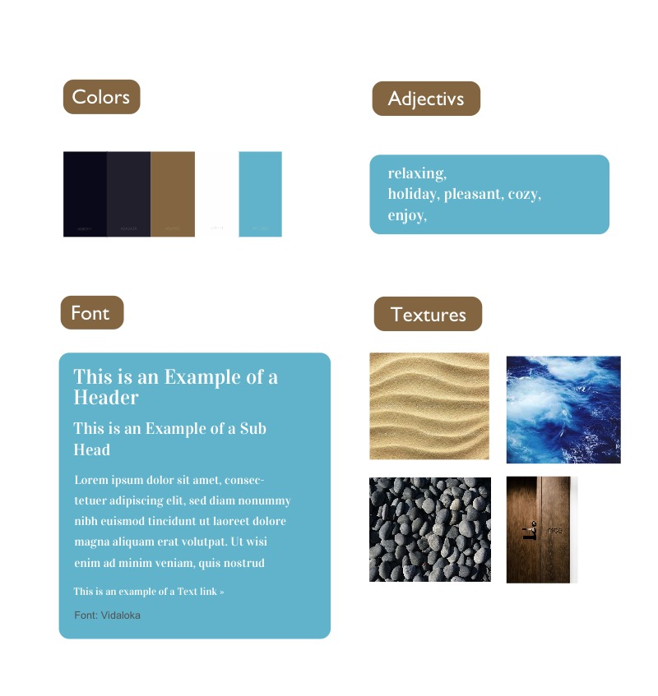
Style tile

Slide 9
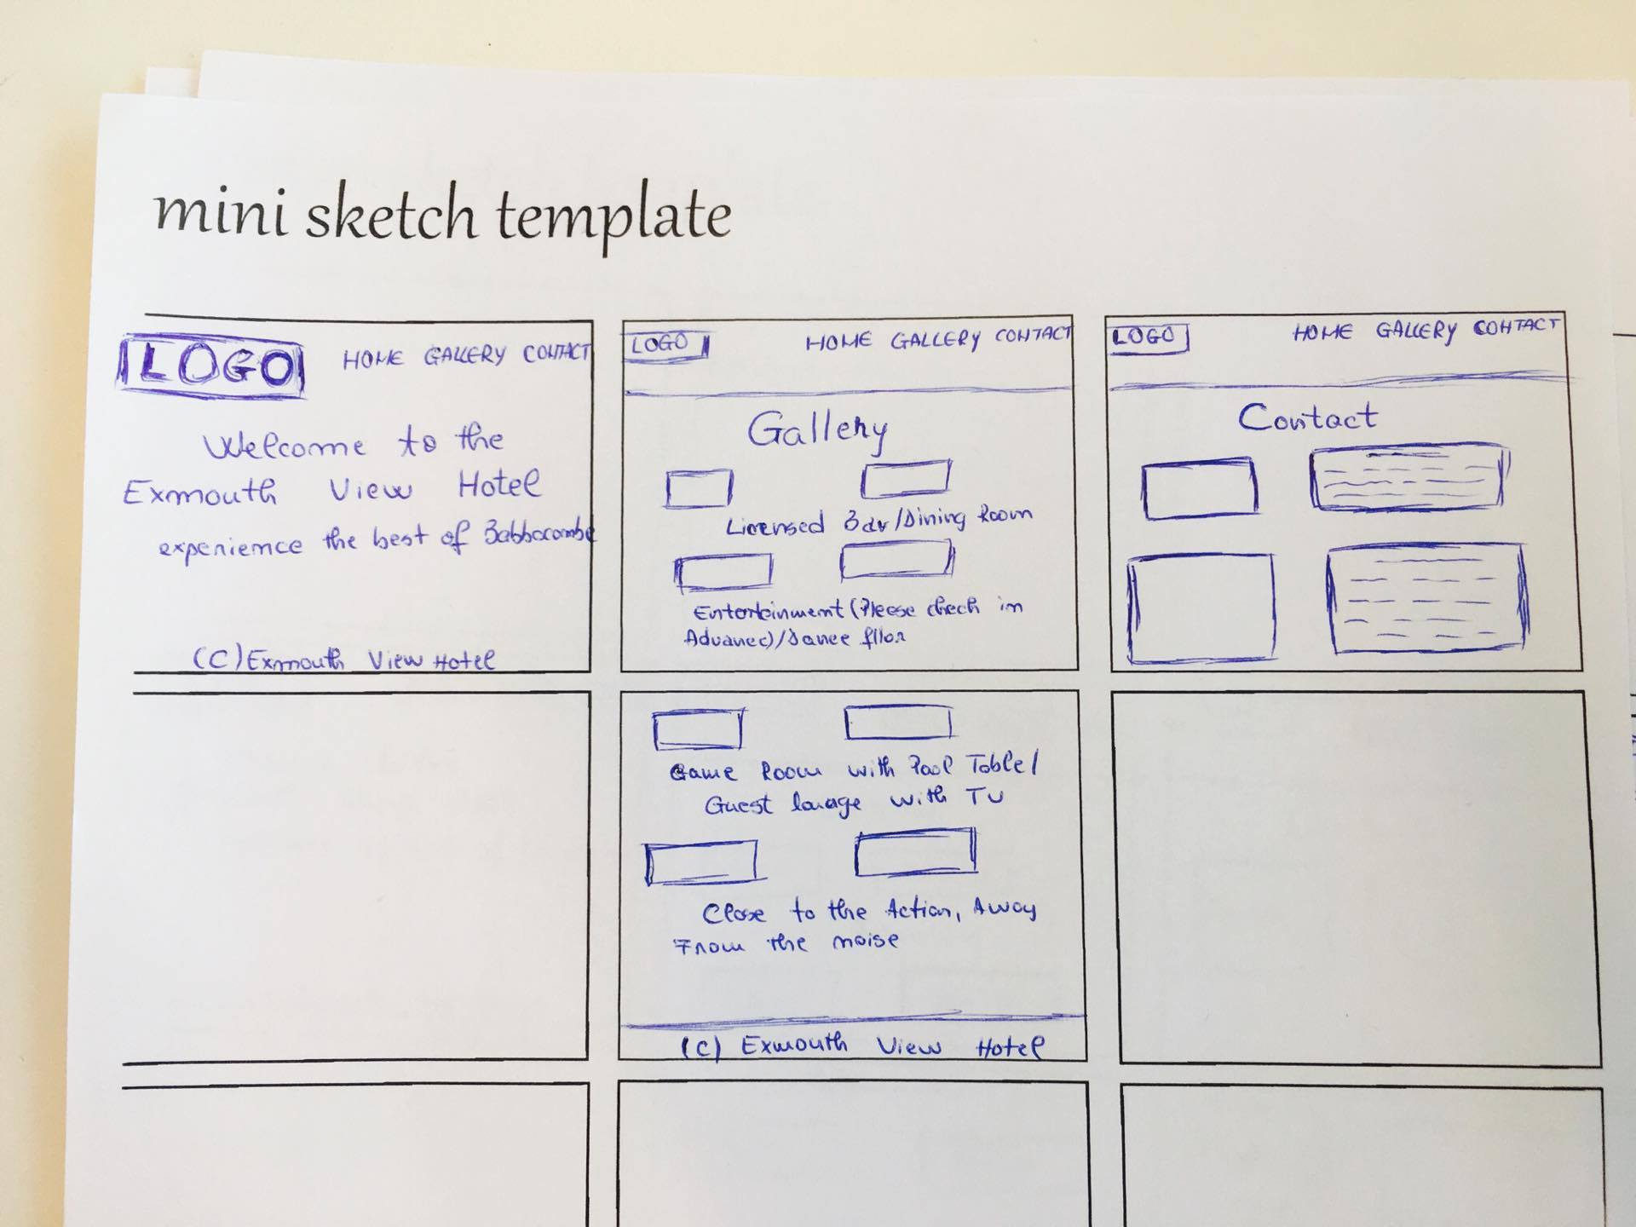
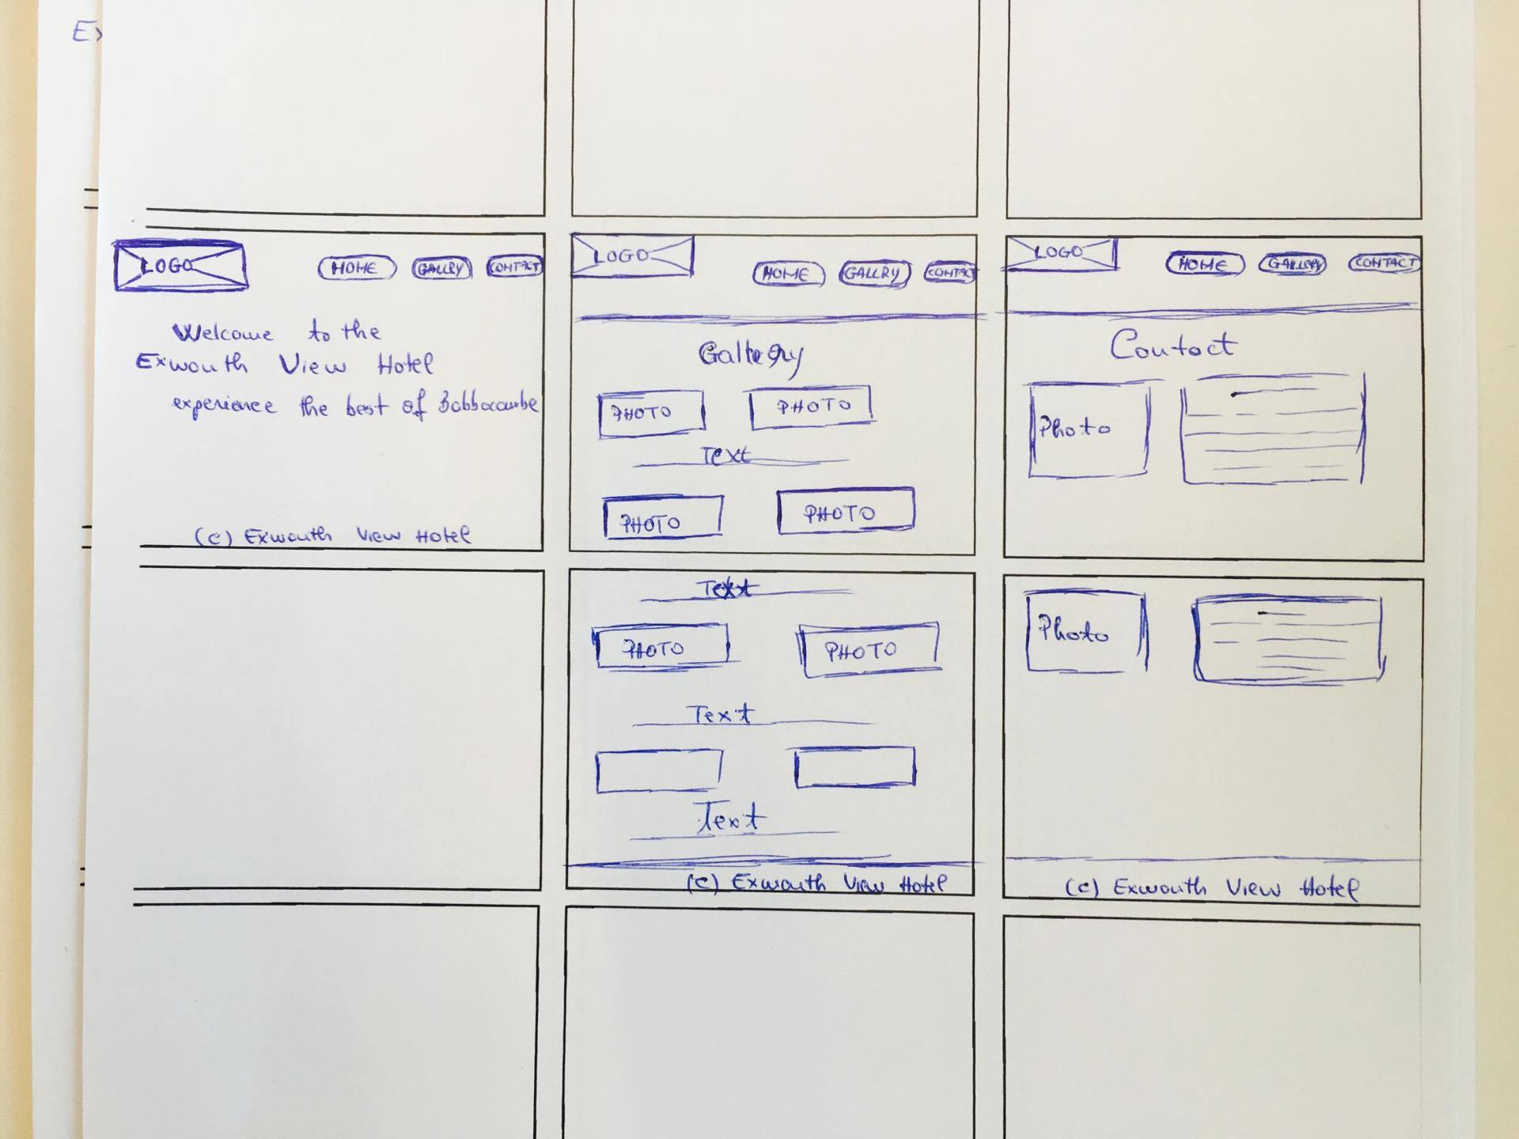
Sketches

Slide 10
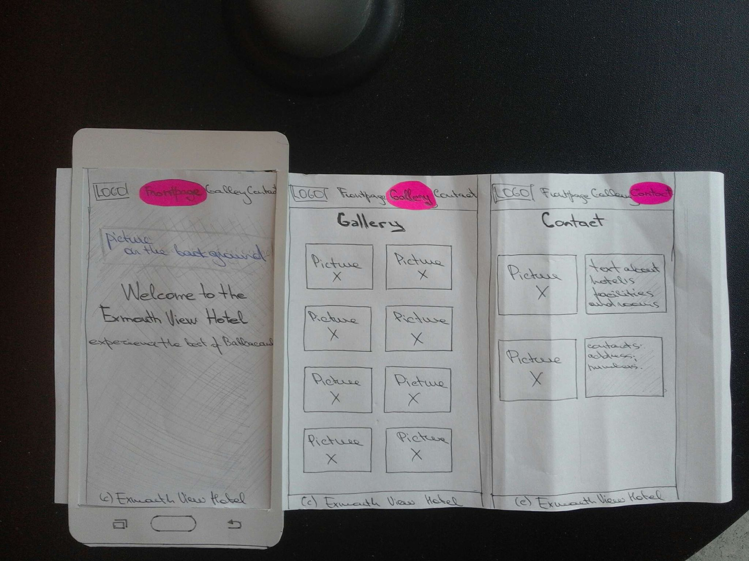
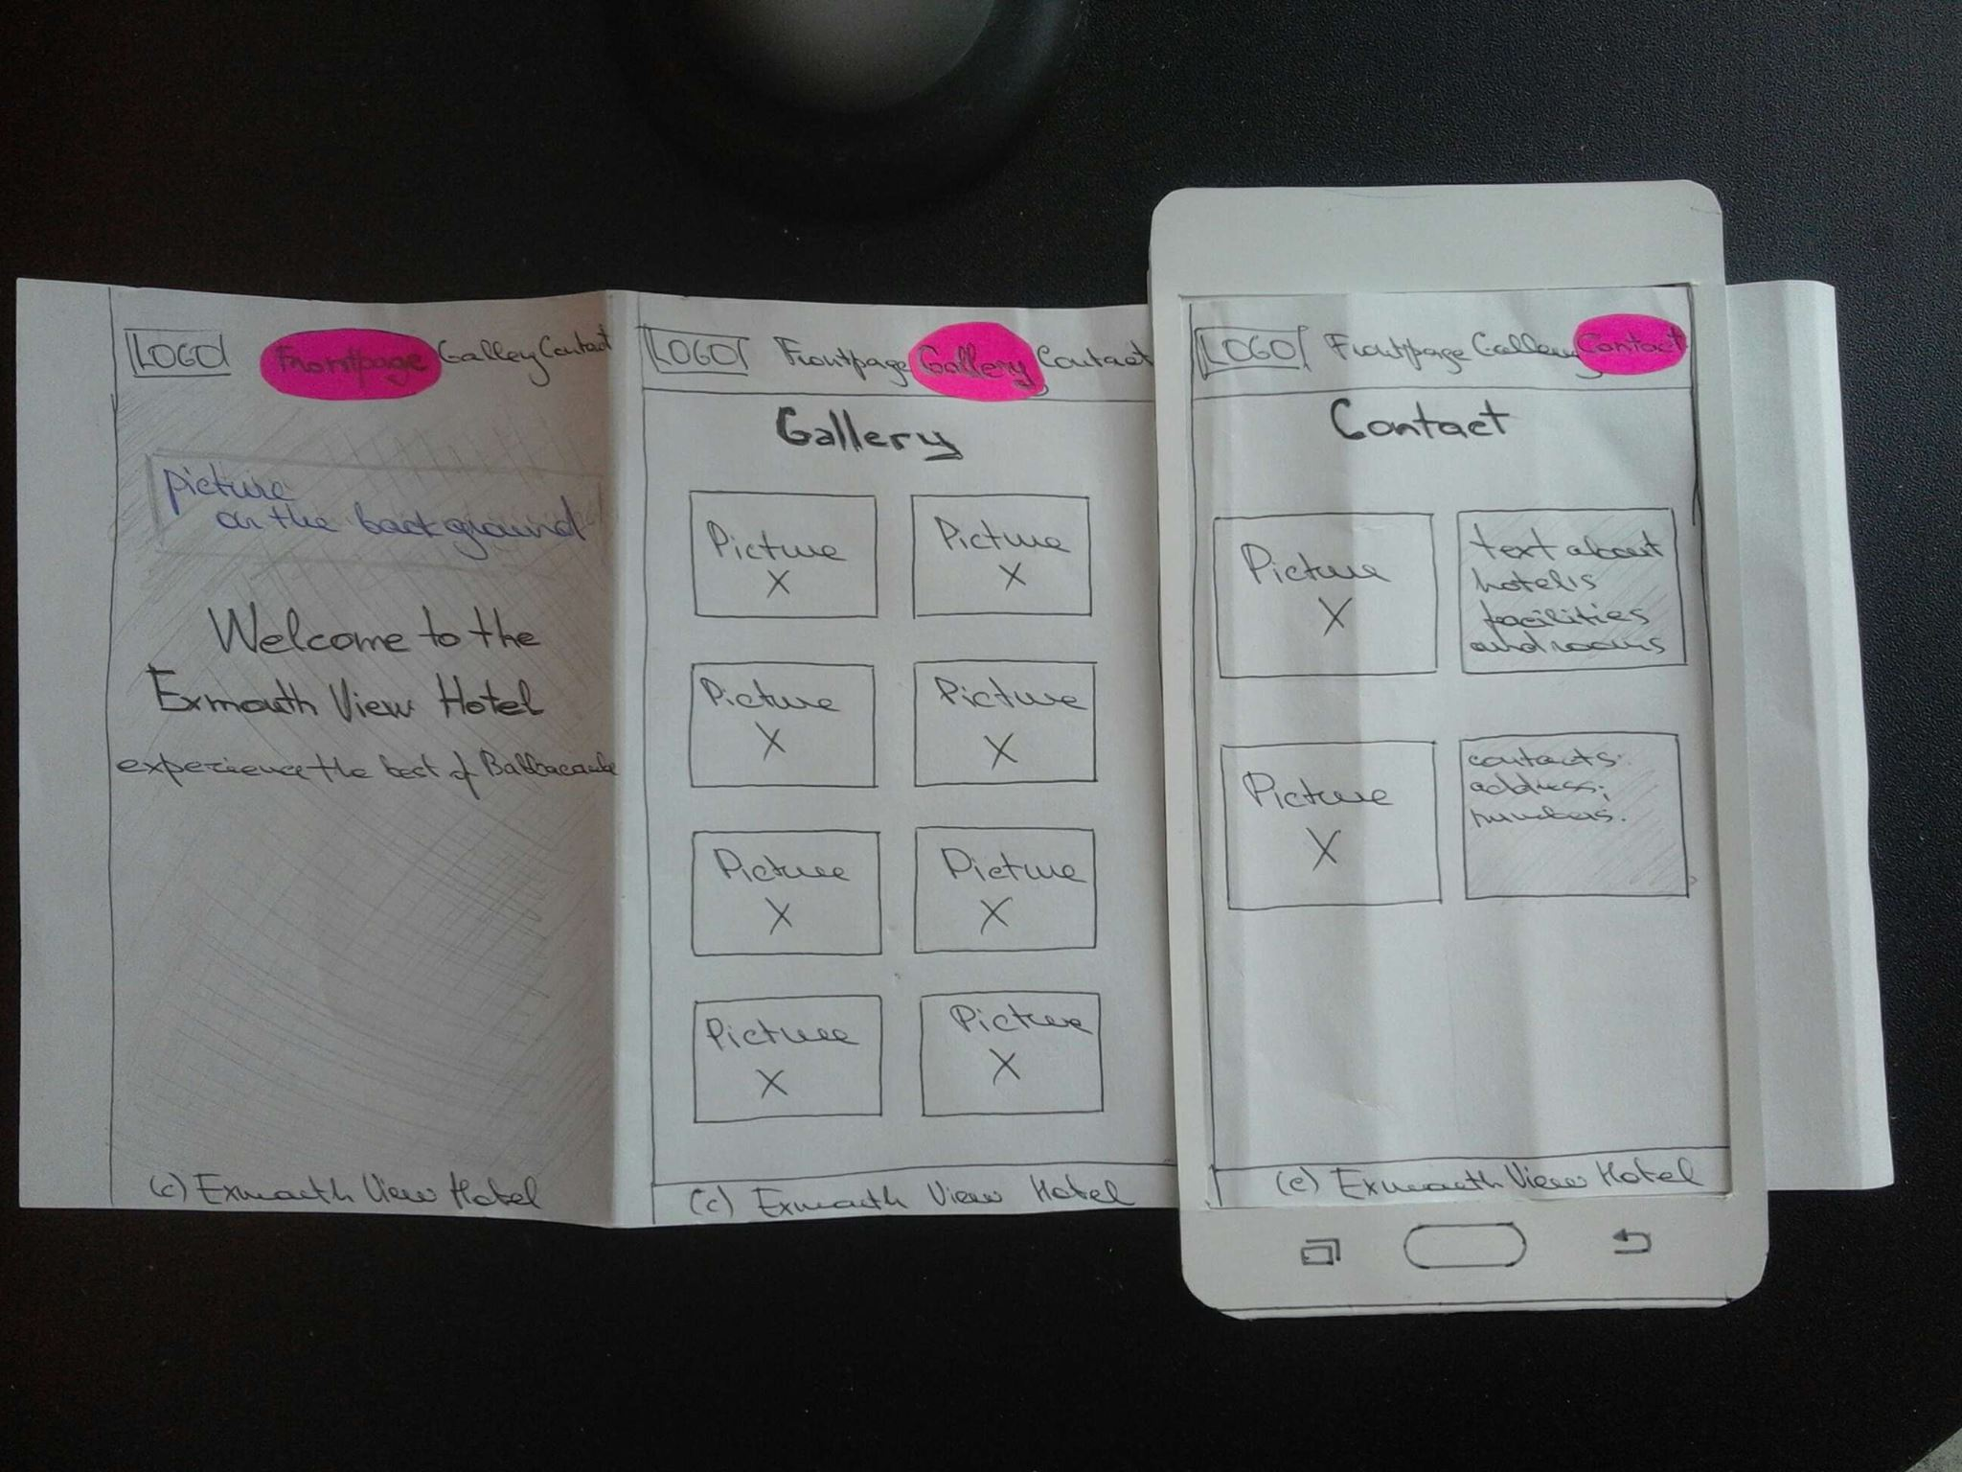
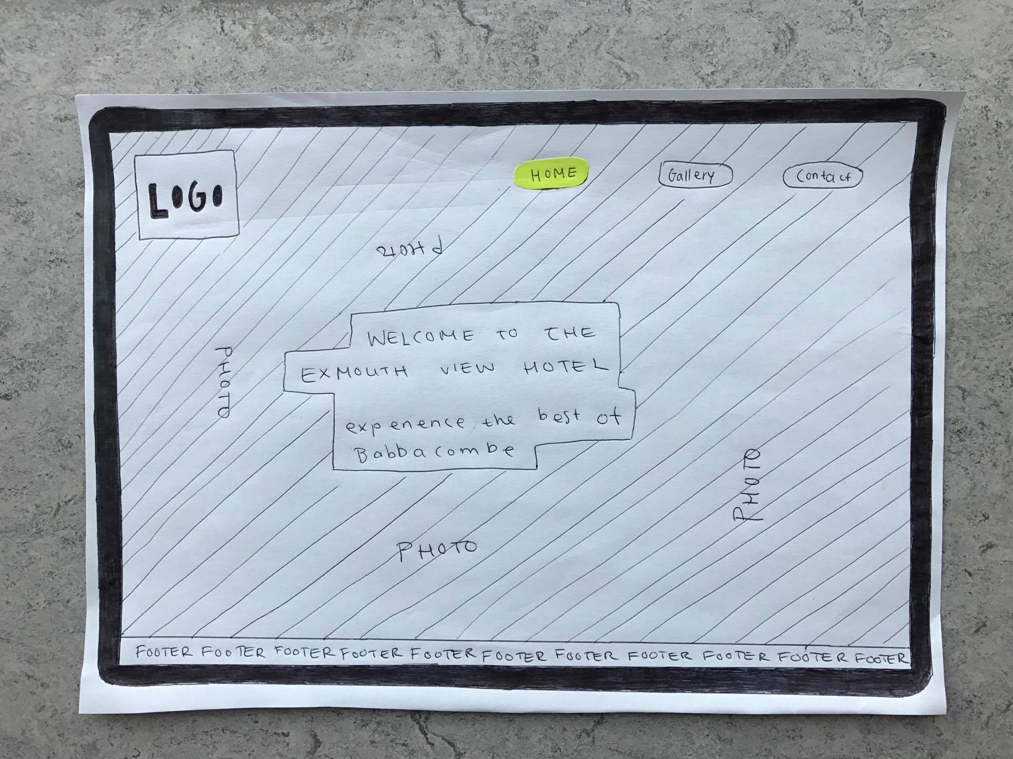
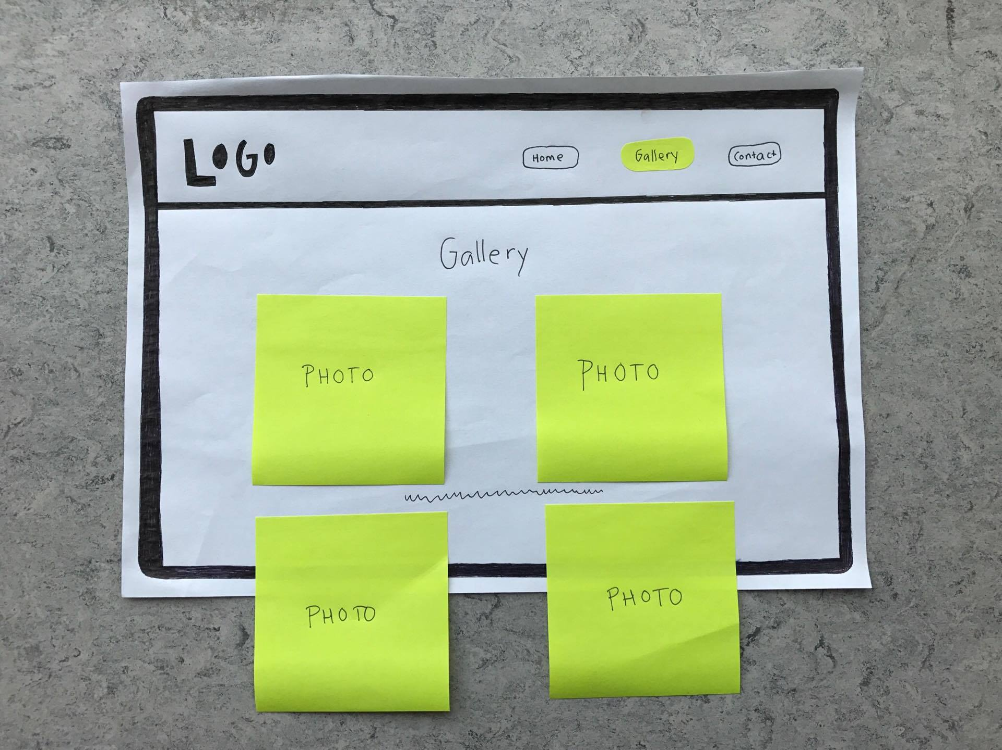
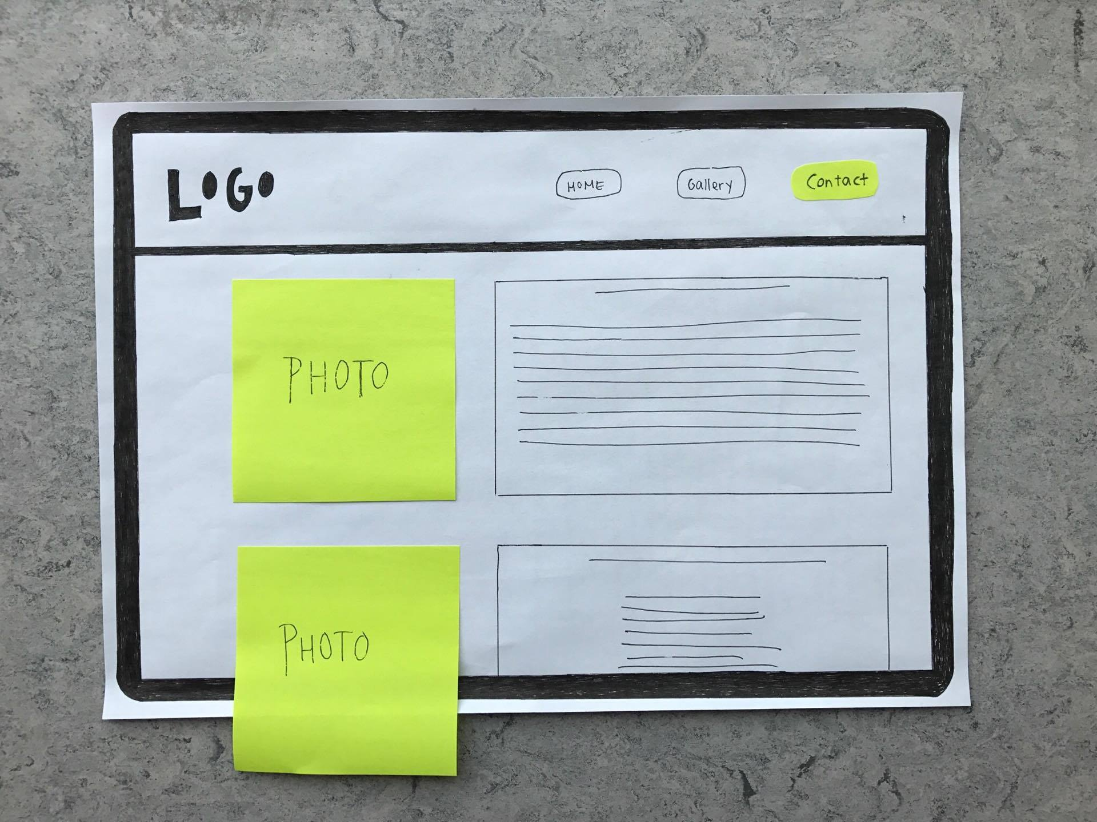
Paper prototypes

Slide 11
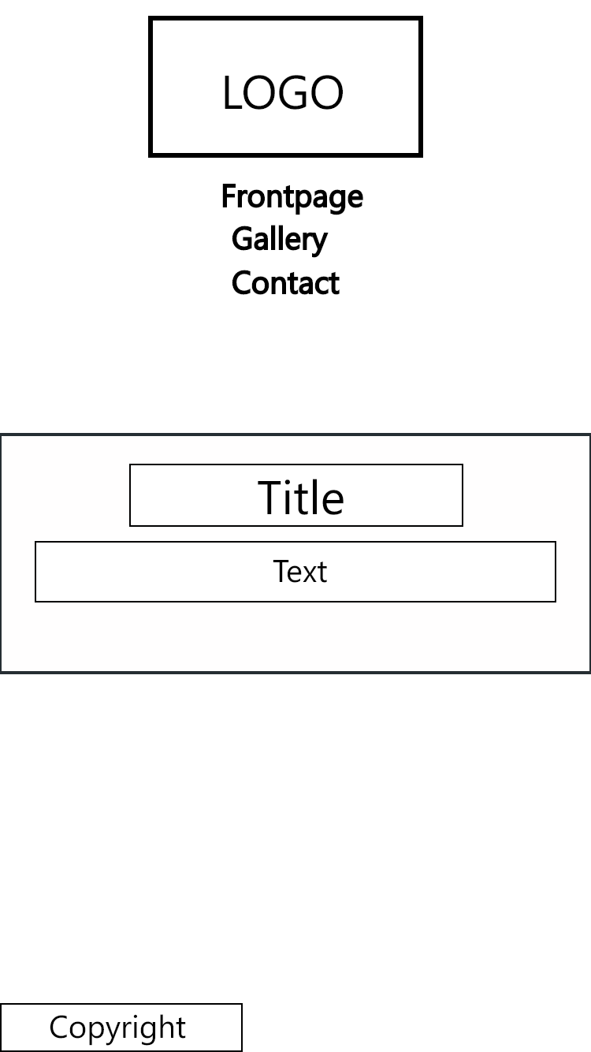
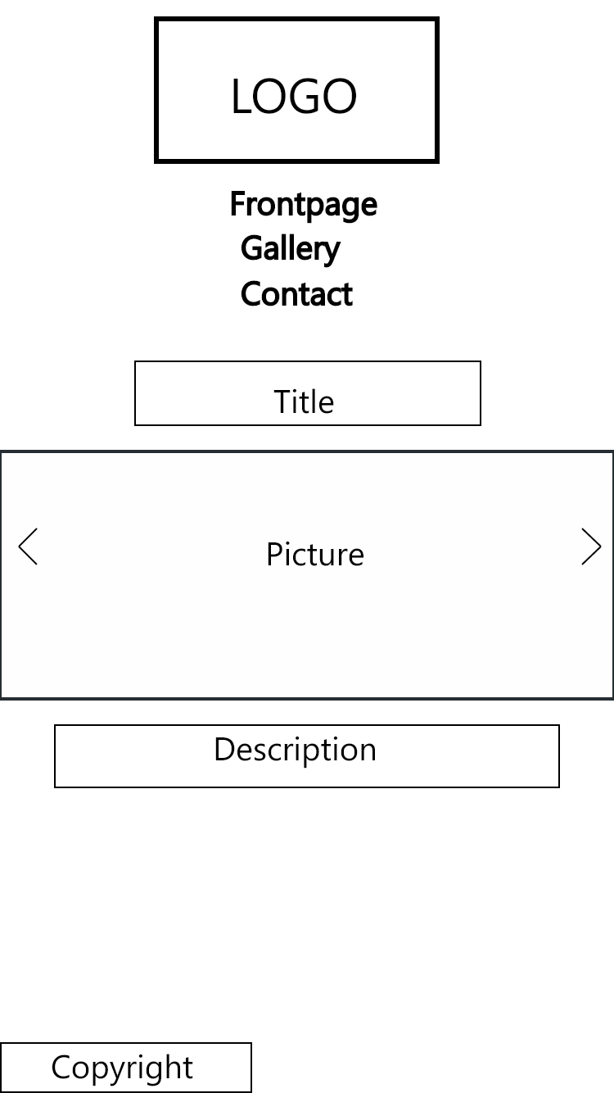
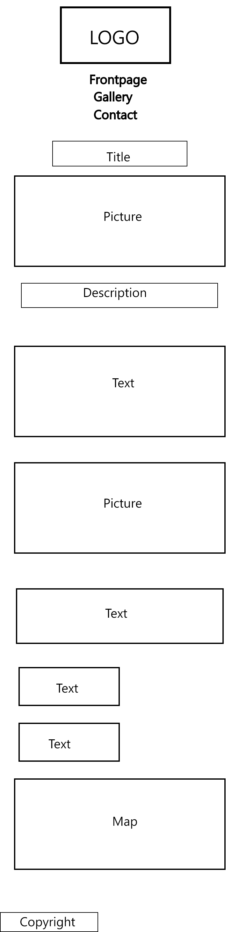
Wireframes

Slide 12
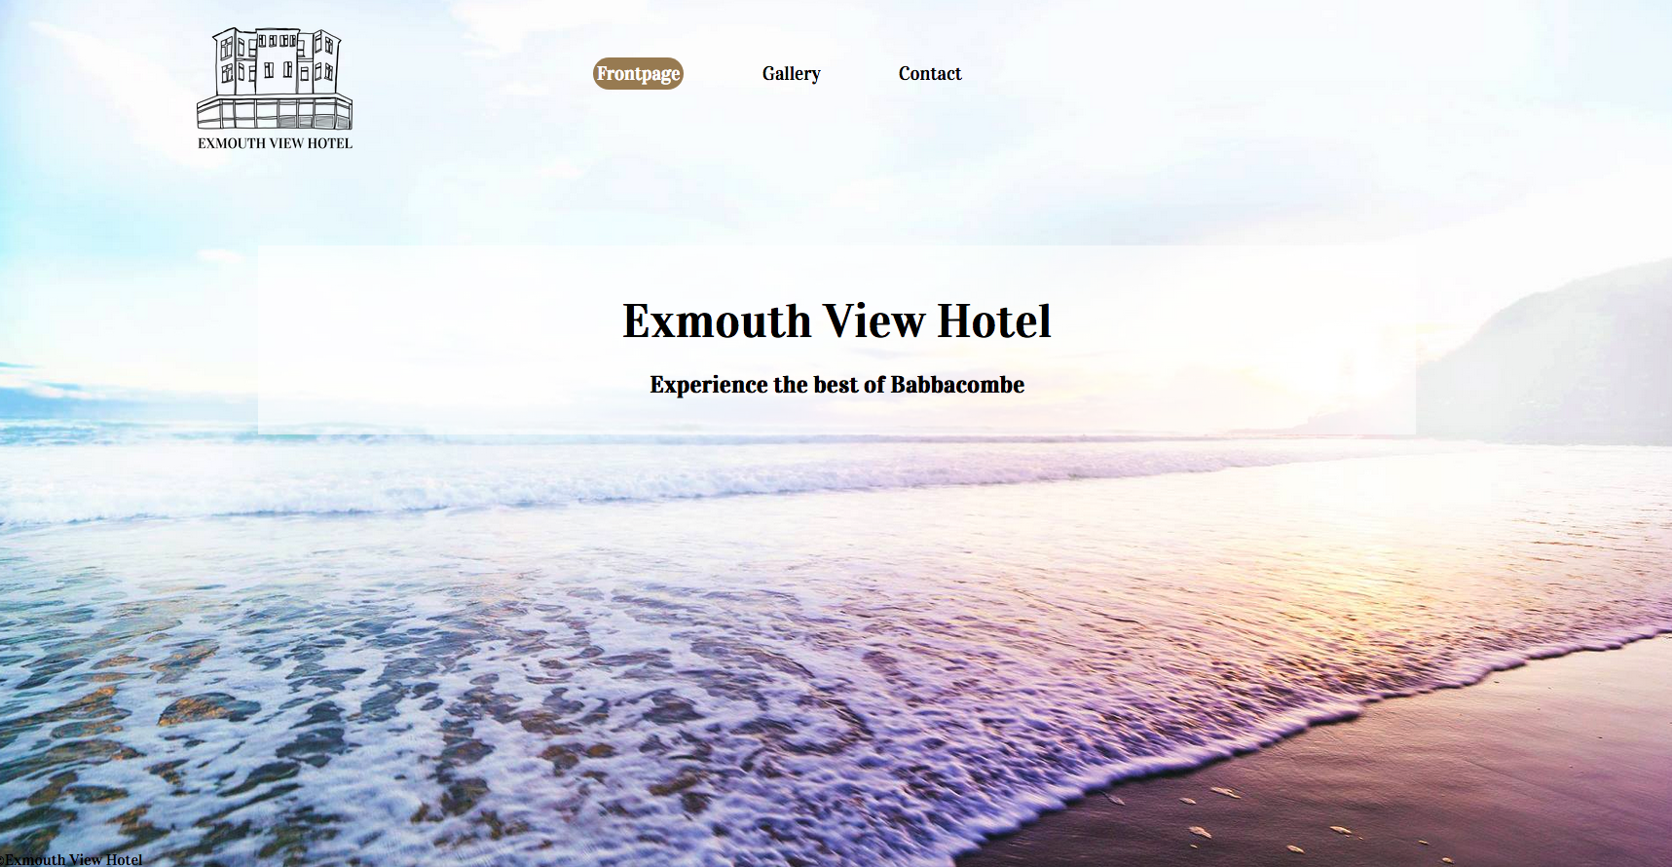
Desktop view

Slide 13

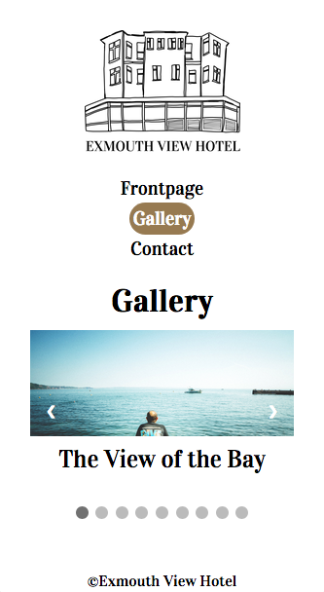
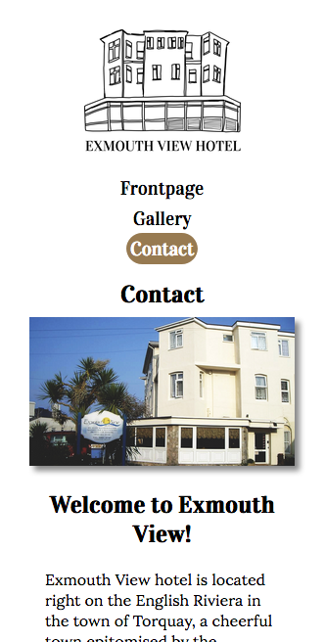
Mobile view

Slide 14
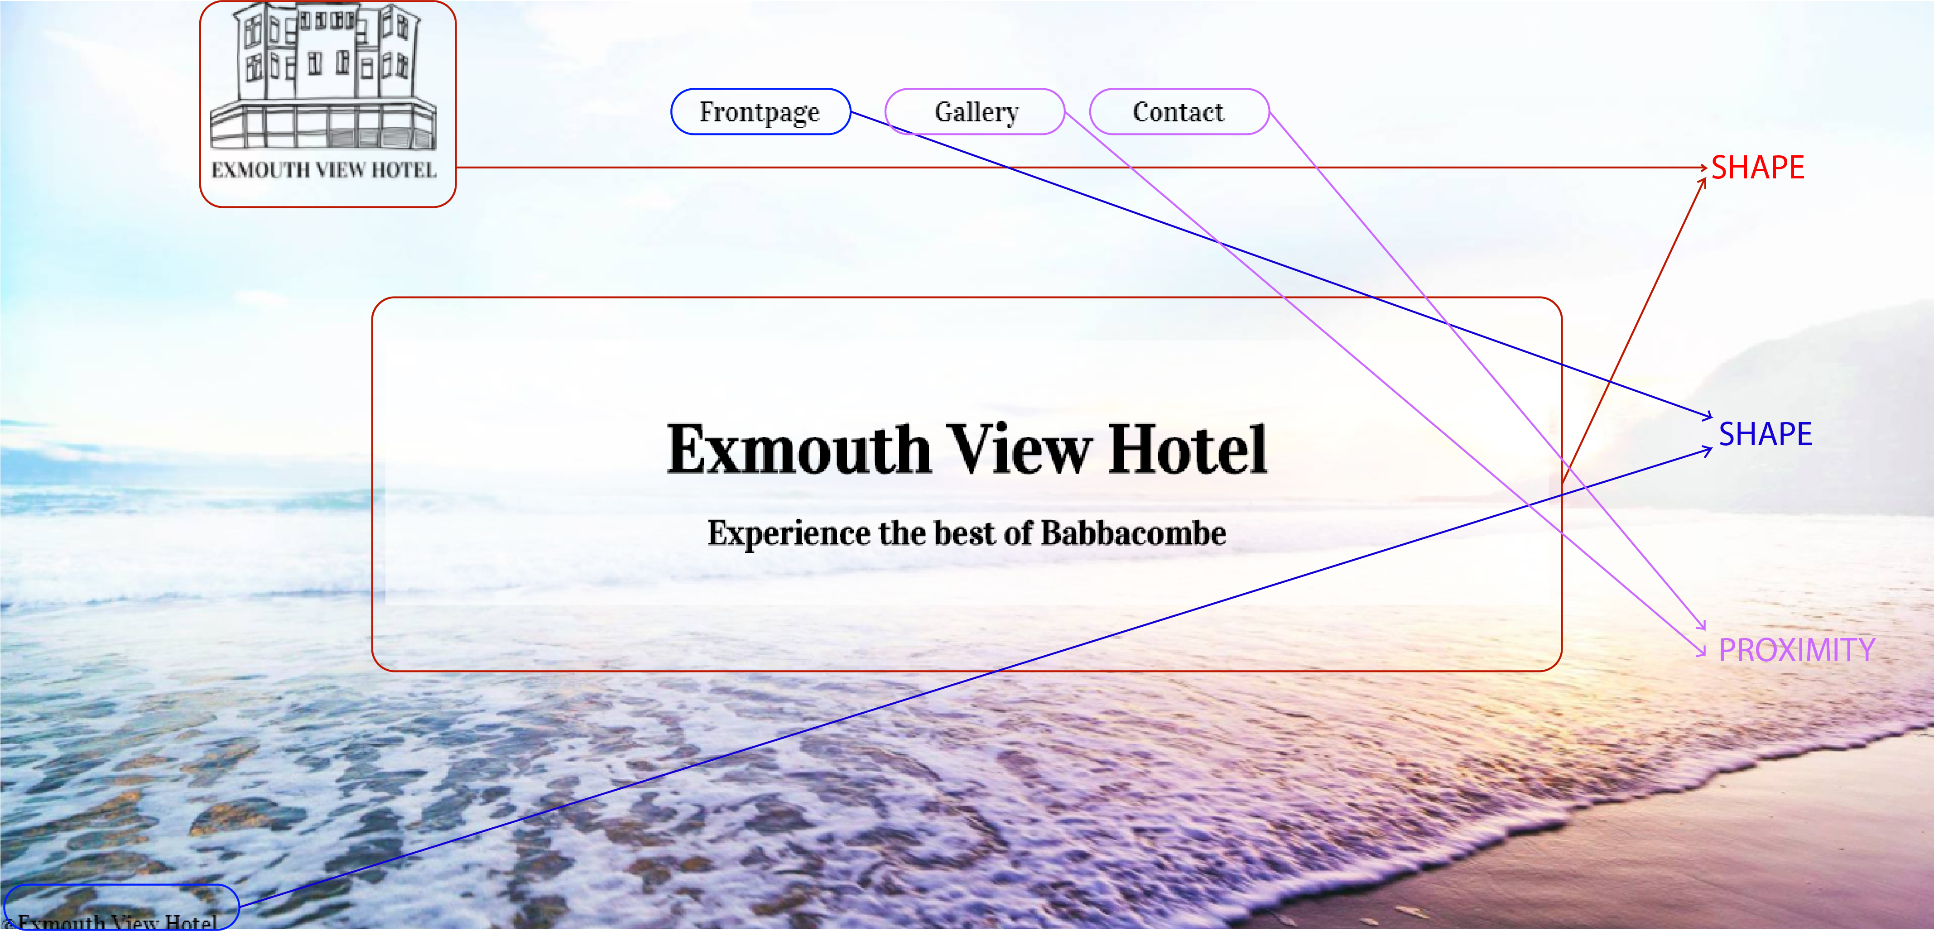
Design principles

Slide 15
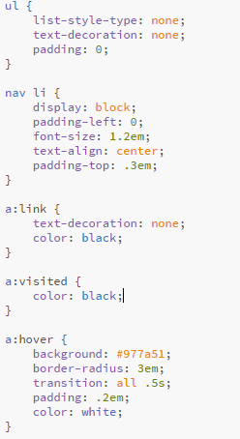
Code snippets

Slide 16
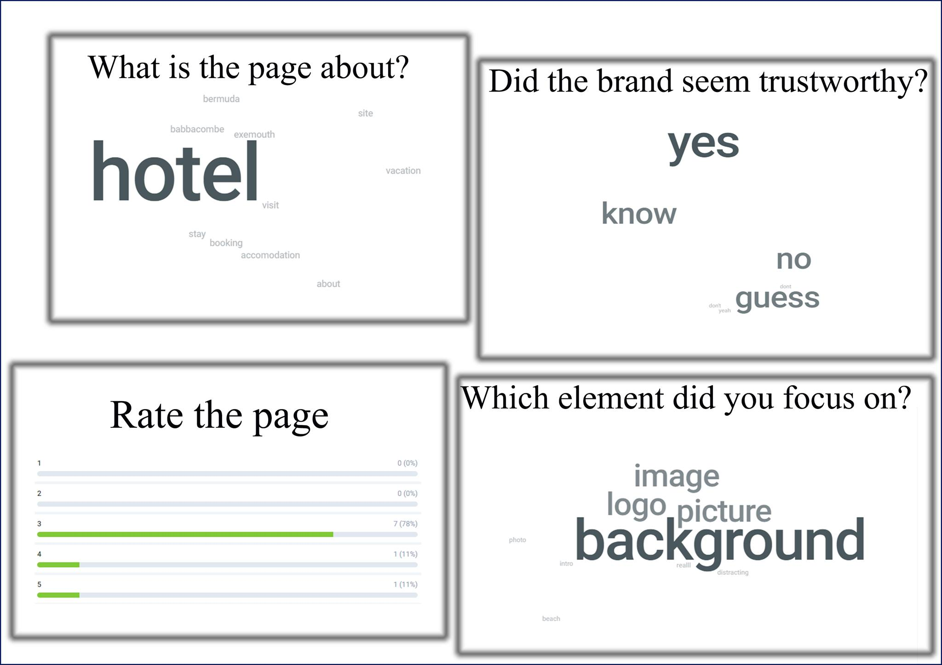
Test results and Changes to enhance Usability

Slide 17

LINKS TO XD-PROTOTYPES
(mobile)
https://xd.adobe.com/view/061354b6-bea2-4b70-949b-37a10e4ad575
(desktop)
https://xd.adobe.com/view/5ae500c0-1941-4be9-8ad4-df71626efdaa/

